Slide 2
Unit 6: Pointers (6hrs)
Introduction
Pointer operators
Pointer arithmetic
Returning multiple values from functions using pointers
Pointers and Arrays
Double indirection
Dynamic memory allocation

Slide 3
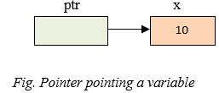
Pointer
A pointer is a variable whose name starts with an asterisk (*).
It stores the memory address of another variable, i.e. direct address of the memory location.
A pointer can point to one specific datatype (i.e. int or float or double or char).
Eg.
int *ptr;
ptr is a pointer variable which points to variable x.

Slide 4
Pointer Declaration
The general form of a pointer declaration is:
Datatype *variable name;
Where,
datatype refers to the type of data
variable name refers to the name of pointer variable
* is used to declare a pointer.
Eg:
int *x; //pointer to an integer
float *x; //pointer to a float

Slide 5
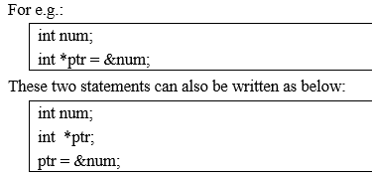
Pointer Declaration

Slide 6
Pointer Operators
Reference operator
Referencing means taking the address of an existing variable
ampersand (&) sign is used.
Eg:
int *p;
p=&x;
Dereference operator
Dereferencing means accessing the value stored in a pointer.
asterisk(*) sign is used.
Eg:
printf("value in pointer:%d\n", *ptr);

Slide 7
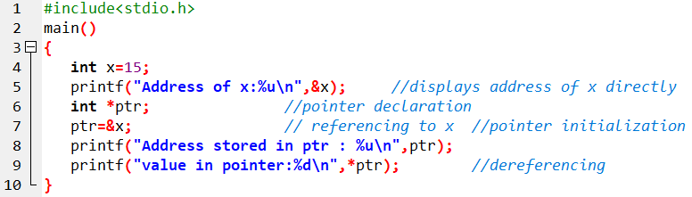

Sample program

Slide 8
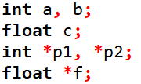
Pointer Arithmetic
We can perform various operations on pointer like as operation on ordinary variables.
Let's us consider the below declaration:

Slide 9
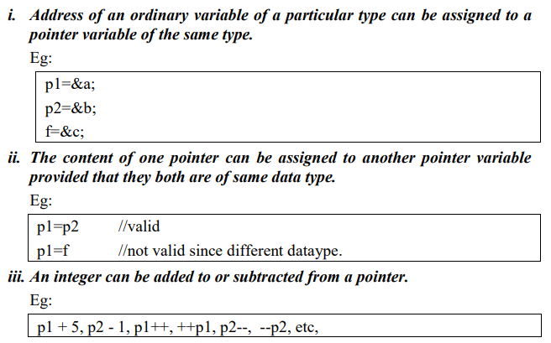

Slide 10
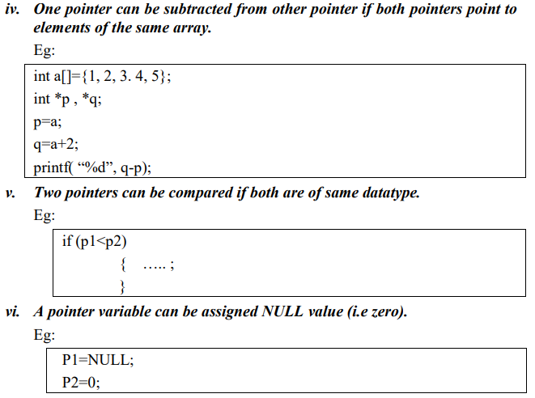

Slide 11
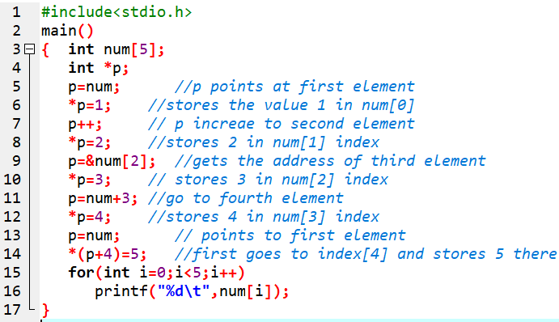

Sample program

Slide 12
Types of Pointer
Void pointer
Null Pointer
Double Pointer

Slide 13

a) Void Pointer
pointer that can point to variables of any datatype (i.e. single pointer can point to int, float, char or other type variables).
Such pointers use the keyword void.
Using Void pointer, the pointed data cannot be directly dereferenced (i.e. simply using *). For this reason, we need to perform type casting to change the type of void pointer to a specific datatype before dereferencing it.

Slide 14
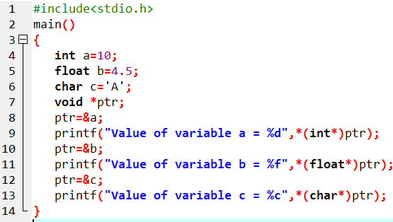

Sample program

Slide 15
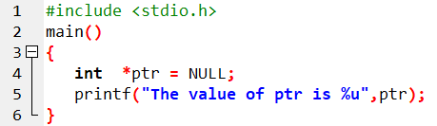

b) Null Pointer
points nowhere or nothing in memory address.
We can define a null pointer using predefined constant NULL
In case we do not have address to be assigned to the pointer, then we simply use NULL.

Slide 16
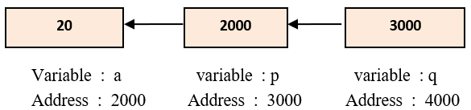
c) Double Pointer
Double pointer refers to a chain of pointer in which one pointer points to another pointer and these in turn point to data.
In case of pointer to pointer declaration, we need to add asterisk(*) for each level of reference.
Here, pointer q holds the value of variable a.

Slide 17
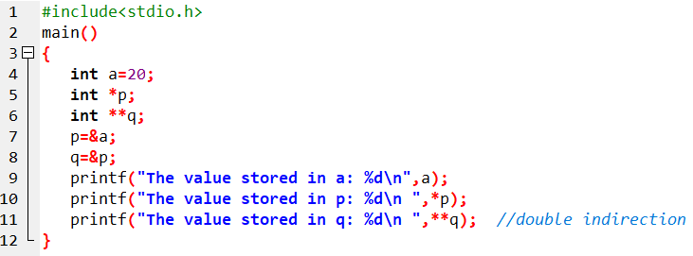

Sample program

Slide 18
7.4 Returning Multiple values from function using pointers
Already dealt in Chapter 6 : Functions

Slide 19
7.5 Arrays of pointer
Basically its an array of pointers that stores memory addresses.
Syntax:
Datatype *pointer-name[size];
Eg.
int *p[5];
Here, p is an array of 5 pointers, each of which points to an integer.
The 1st pointer is called p[0],
the 2nd is p[1], and
so on up to p[4].

Slide 20
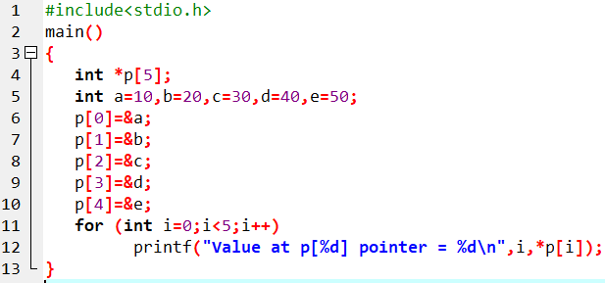
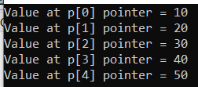
Sample program

Slide 21
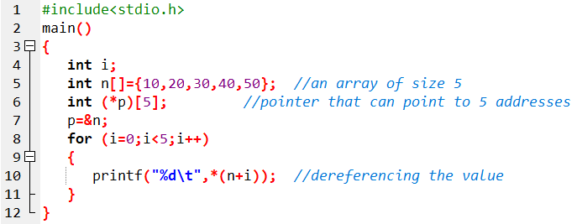
7.6 Pointer to Array
Not only a pointer points to a single variable.
We can also point the whole array using pointers.
Using array pointer, we can easily manipulate the mulit-dimensional array.
Here, pointer p points the entire array n.
(*p)[i]);

Slide 22
7.7 Relationship between array and pointer
An array is a block of sequential data.
In most contexts, array names decay to pointers.
In simple words, array names are converted to pointers.
That's the reason why we can use pointers to access elements of arrays.

Slide 23
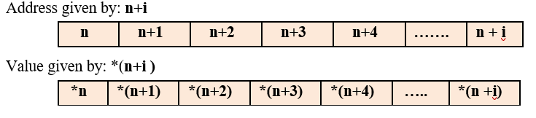
1-D array and Pointer relationship

Slide 24
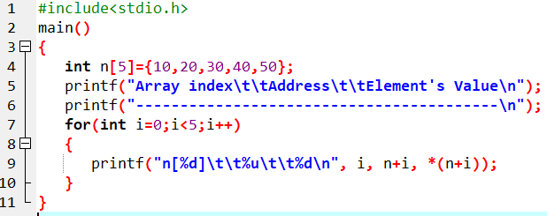
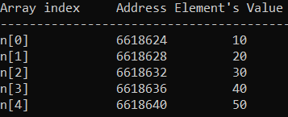
WAP to initialize an 1D array of 5 elements as 10, 20, 30, 40, 50 and display the elements with their memory address using array name as a pointer

Slide 25
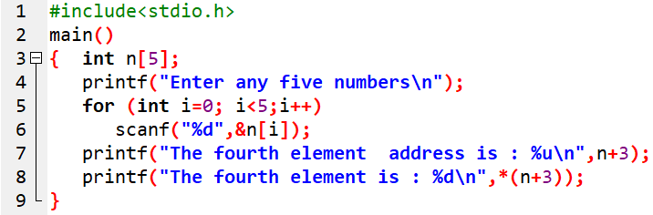

WAP using array to accept any five numbers and display the value stored only in the fourth address of the array using pointer and also its address.

Slide 26
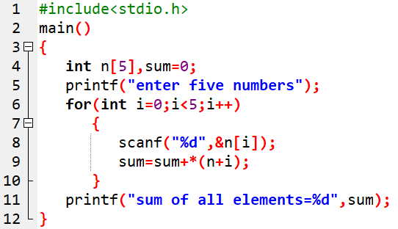

WAP using array to input any five numbers and compute the sum of all the elements using pointer.

Slide 27
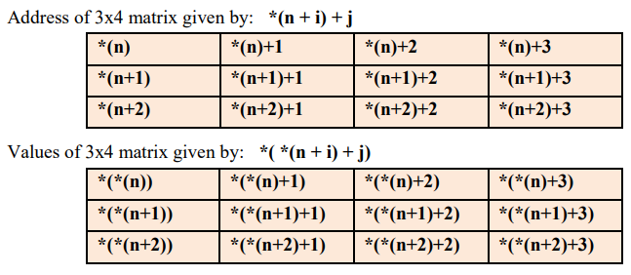
Relationship between 2-D array and pointer

Slide 28
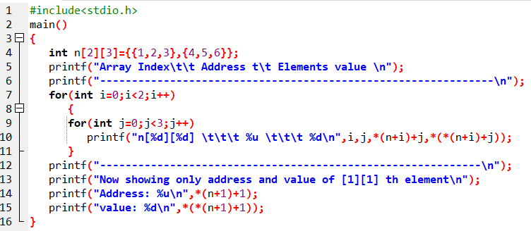
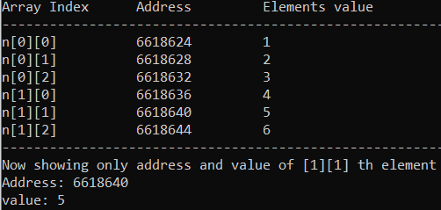
WAP to initialize any 2x3 matrix at compile time and display the address and value stored in it. Also display the address of the element at index[1][1] separately.

Slide 29
7.4 Pointers for string
A string is an array of character.
An array name is itself pointer which points to first element of the array.
Thus, string and pointer are closely related.
Eg.
char name[5] = “Shiva”; // equivalent to char *name = “shiva”;
Here, the string variable name is an array of characters (i.e. * name is a pointer).
Thus it can be used to access and manipulate the characters of the string.
name prints “Shiva”
name+1 prints “hiva”
name+2 prints “iva” and so on.
name + i prints the characters in string name starting from the i^{th} position.

Slide 30
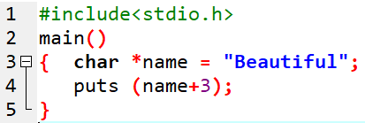

Sample program

Slide 31
End of Lecture 13

Slide 32
Dynamic Memory Allocation

